Slide 1
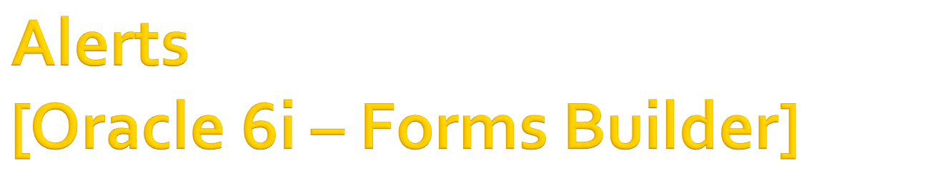

Slide 2

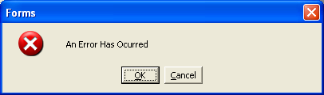
Alerts are dialog boxes that appear until the user dismisses them.
They main purpose is error-handling
To create an alert, click the Alert group in the Object Navigator and use create button.

Slide 3

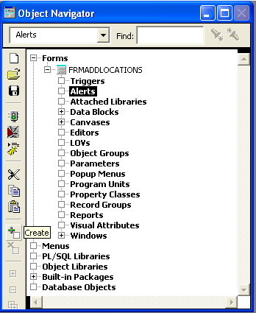
Open Object Navigator (Press F3)
Select Alerts under Forms
Create Manually (Press +)

Slide 4

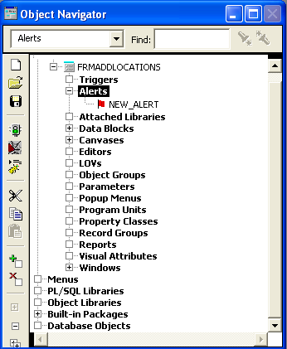
Newly Created Alert After Rename

Slide 5

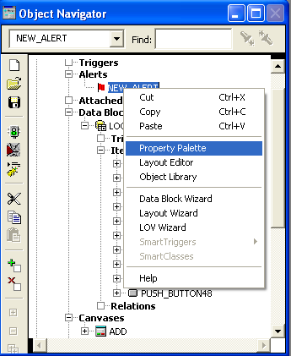
To set the message, the type and name of the alert, it can be done through the property palette of the created alert, as shown in the next slide
Open property palette of the alert, right click on the created alert

Slide 6

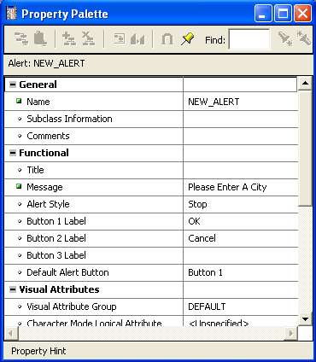
Alert Name
Message to be displayed
Symbol displayed in Alert

Slide 7

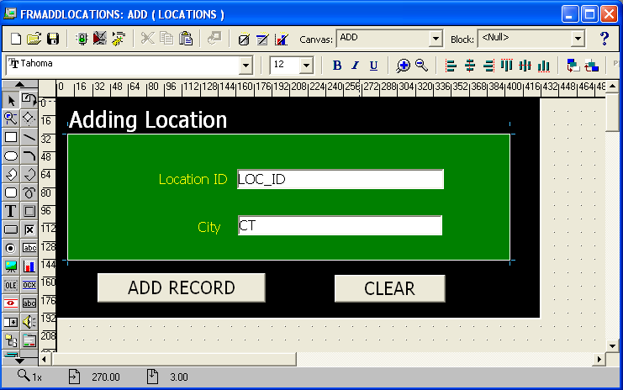

Slide 8

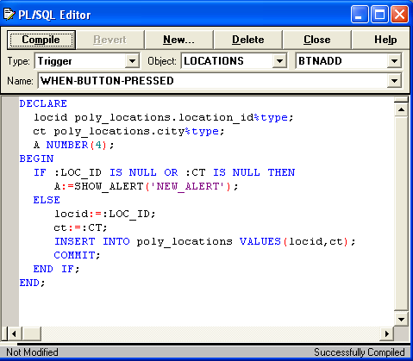

Slide 9

In the smart trigger event (‘WHEN_BUTTON_PRESSED’) of a button, add the following code to display the alert message.
DECLARE
a1 NUMBER;
BEGIN
IF :TXTCITY = NULL THEN
a1:=SHOW_ALERT('new_alert');
END IF;
END;
Function_Name(‘Alert_Name’)

Slide 10

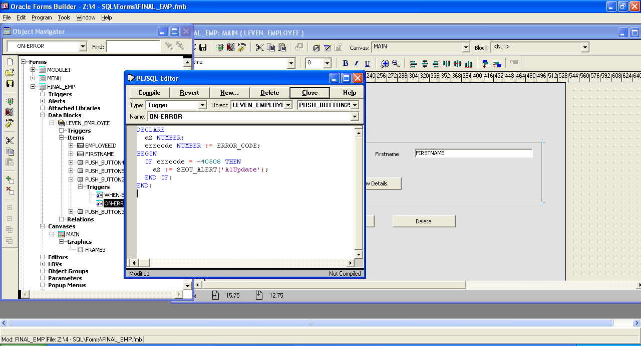
When UPDATE command has failed to update a record

Slide 11
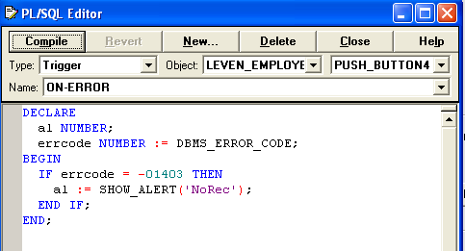
When SELECT command has failed to find a record based on a given criteria

